Slide 1

AZURE SQL
Ideals induced, imbibed and implemented!

Slide 2

Azure SQL: Cloud-Based Database Solution
Essential strategies for efficient cloud database management
Notes:
AI-generated content may be incorrect. --- This presentation provides a thorough overview of Azure SQL, covering fundamentals, design best practices, migration strategies, security, availability, integrations, and performance optimization to help you master cloud-based database solutions. Image source: Microsoft 365 content library

Slide 3

Agenda Overview
Fundamentals of Azure SQL
Database Design and Development Best Practices
Data Migration Strategies to Azure SQL
Security and Compliance in Azure SQL
High Availability and Disaster Recovery Solutions
Integrating Azure SQL with Azure Services
Performance Monitoring and Optimization
Notes:
--- We will begin with the fundamentals of Azure SQL, then explore database design and development best practices. Next, we will cover data migration strategies, security and compliance, high availability and disaster recovery, integration with Azure services, and conclude with performance monitoring and optimization. Image source: Microsoft 365 content library

Slide 4
Fundamentals of Azure SQL
Notes:
Understanding the core components and architecture of Azure SQL is essential for effective cloud database management. We will also explore deployment options and how to navigate the Azure Portal interface.

Slide 5

Core Concepts and Architecture of Azure SQL
Managed Relational Database
Azure SQL is a fully managed relational database service built on SQL Server technology for ease of use.
Scalability and Elasticity
The architecture supports elastic compute and storage to scale resources dynamically based on workload demands.
High Availability and Security
Azure SQL ensures high availability and robust security features to protect data in cloud environments.
Notes:
--- Azure SQL is a fully managed relational database service based on Microsoft SQL Server technology. It offers scalability, high availability, and security through a cloud-native architecture designed for elastic compute and storage. Image source: Microsoft 365 content library

Slide 6

Exploring Deployment Options: Single Databases, Elastic Pools, and Managed Instances
Single Databases
Single databases support isolated workloads with dedicated resources and simplified management.
Elastic Pools
Elastic pools enable cost-efficient resource sharing among multiple databases with dynamic scaling.
Managed Instances
Managed instances offer near full SQL Server compatibility with enhanced control and security features.
Notes:
--- Azure SQL supports various deployment models including single databases for isolated workloads, elastic pools for cost-efficient shared resource management, and managed instances that offer near 100% SQL Server compatibility with enhanced control. Image source: Microsoft 365 content library

Slide 7

Navigating and Utilizing the Azure Portal Interface
User-Friendly Interface
The Azure Portal offers an intuitive web interface designed for easy management of cloud resources.
Resource Monitoring
Built-in tools allow real-time monitoring of Azure SQL databases and resource performance.
Configuration and Deployment
Users can configure, scale, and deploy databases efficiently using integrated portal tools.
Notes:
--- The Azure Portal provides a user-friendly web interface for managing Azure SQL resources. It enables monitoring, configuration, scaling, and deploying databases with ease through dashboards and integrated tools. Image source: Microsoft 365 content library

Slide 8
Database Design and Development Best Practices
Notes:
Designing efficient and scalable schemas, writing effective T-SQL code, and optimizing performance through indexing are critical to successful Azure SQL deployments.

Slide 9
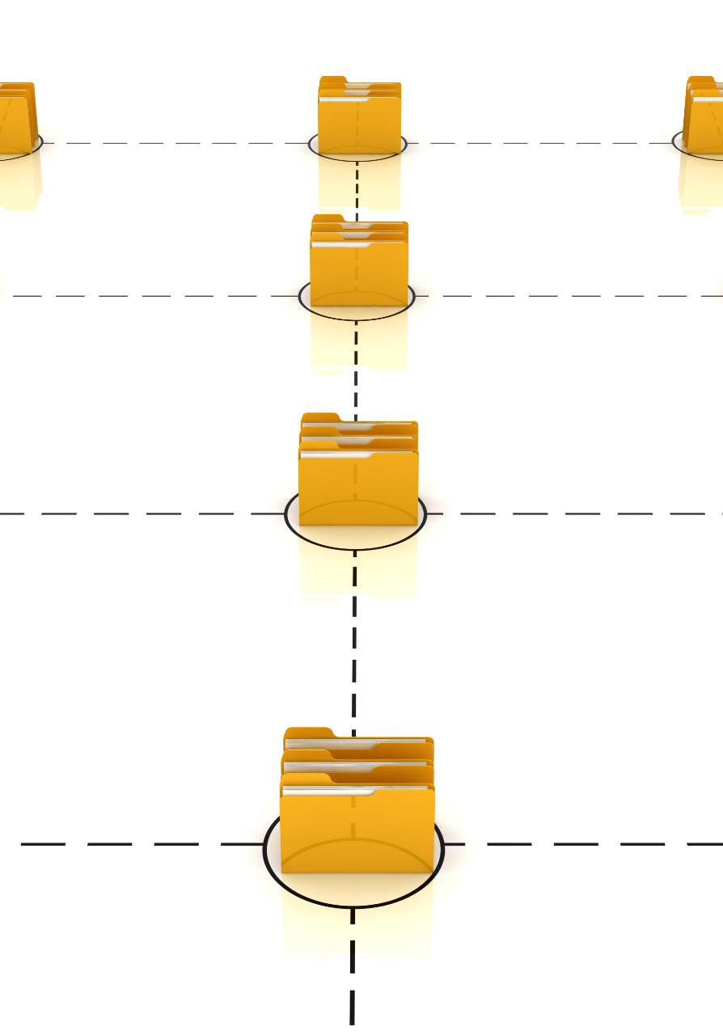
Designing Efficient and Scalable Database Schemas
Normalization Principles
Normalization organizes database tables to reduce data redundancy and improve data integrity.
Indexing Strategies
Effective indexing speeds up data retrieval and enhances query performance in large databases.
Partitioning for Scalability
Partitioning divides large databases into manageable segments to optimize performance and scalability.
Notes:
--- Schema design should focus on normalization, indexing strategies, and partitioning to ensure scalability and performance. Proper design reduces data redundancy and improves query efficiency. Image source: Microsoft 365 content library

Slide 10

T-SQL Programming Techniques and Best Practices
Use Parameterized Queries
Parameterized queries protect against SQL injection and improve code maintainability and security.
Avoid Cursors
Avoid using cursors to enhance query performance and reduce resource consumption in T-SQL programming.
Leverage Set-Based Operations
Using set-based operations leads to more efficient and faster T-SQL queries compared to row-by-row processing.
Notes:
--- Writing clean, maintainable, and efficient T-SQL code involves using parameterized queries, avoiding cursors when possible, and leveraging set-based operations for better performance. Image source: Microsoft 365 content library

Slide 11

Performance Tuning and Effective Indexing Strategies
Query Monitoring and Tuning
Continuous monitoring of queries identifies performance bottlenecks and opportunities for tuning to reduce latency.
Clustered Index Importance
Clustered indexes organize data to speed up data retrieval and improve query performance.
Non-Clustered Index Benefits
Non-clustered indexes provide quick access paths to data, enhancing responsiveness without altering data storage.
Notes:
--- Regular monitoring and tuning of queries, along with creating appropriate clustered and non-clustered indexes, help to minimize latency and maximize responsiveness in Azure SQL databases. Image source: Microsoft 365 content library

Slide 12
Data Migration Strategies to Azure SQL
Notes:
Migrating data to Azure SQL requires careful planning around schema conversion, data transfer, and minimizing downtime to ensure a smooth transition.

Slide 13

Techniques for Schema Conversion and Compatibility
Schema Conversion Tools
Specialized tools automate schema conversion to maintain data integrity during migration to cloud environments.
Handling Feature Differences
Conversion tools address differences in database features and syntax to ensure compatibility across platforms.
Azure Migration Assistance
Azure Database Migration Service simplifies transitioning on-premises databases to Azure SQL with minimal disruption.
Notes:
--- Tools like Azure Database Migration Service assist in converting on-premises schemas to Azure SQL-compatible formats, handling differences in features and syntax seamlessly. Image source: Microsoft 365 content library

Slide 14

Efficient Data Transfer Methods and Tooling
Transactional Replication
Transactional replication enables real-time data copying with minimal downtime, ideal for continuous data synchronization.
Bulk Copy Tools
Bulk copy tools efficiently transfer large volumes of data quickly, suitable for high data loads and offline migration.
Azure Data Factory Pipelines
Azure Data Factory pipelines orchestrate complex data workflows, balancing volume and downtime to optimize migration.
Notes:
--- Data migration can be performed using methods such as transactional replication, bulk copy tools, or Azure Data Factory pipelines, depending on data volume and downtime tolerance. Image source: Microsoft 365 content library

Slide 15

Approaches to Minimize Downtime During Migration
Offline Migration Timing
Perform migrations during low-traffic periods to reduce impact on users and business activities.
Transactional Replication
Use transactional replication to keep data synchronized and minimize downtime during migration.
Phased Cutovers
Implement phased cutovers to gradually shift operations, ensuring smooth transition and minimal disruption.
Notes:
--- Strategies like offline migration during low-traffic periods, transactional replication, and phased cutovers help minimize disruption to business operations during migration. Image source: Microsoft 365 content library

Slide 16
Security and Compliance in Azure SQL
Notes:
Protecting data with robust access control, encryption, auditing, and compliance with regulations is vital for secure cloud database management.

Slide 17
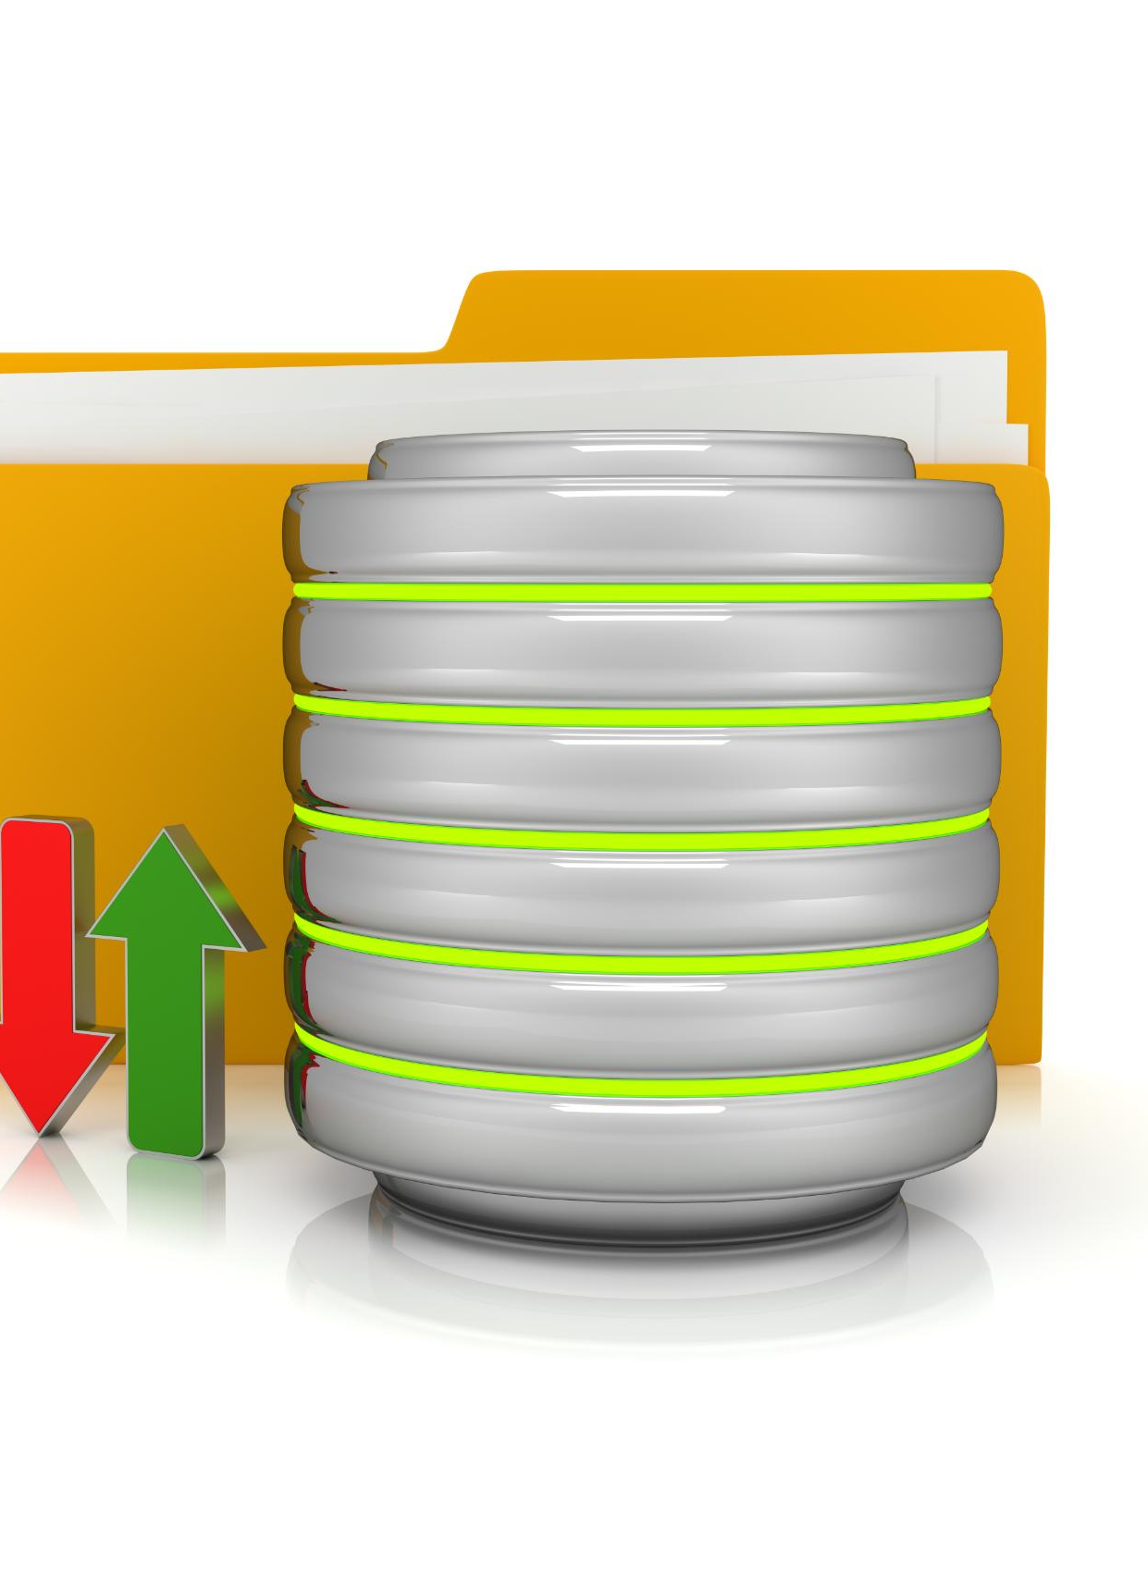
Implementing Robust Access Control and Authentication
Role-Based Access Control
Role-based access control restricts data access based on user roles, enhancing security and management.
Directory Integration
Integration with directory services enables centralized user authentication and streamlined access management.
Multi-Factor Authentication
Multi-factor authentication adds a layer of security by requiring multiple verification methods for access.
Notes:
--- Azure SQL supports role-based access control, Active Directory integration, and multi-factor authentication to ensure that only authorized users access sensitive data. Image source: Microsoft 365 content library

Slide 18

Encryption, Auditing, and Data Protection Features
Transparent Data Encryption
Encrypts stored data automatically to protect information at rest without affecting database performance.
Always Encrypted Feature
Ensures sensitive data is encrypted during transmission and remains inaccessible to unauthorized users.
Advanced Auditing Capabilities
Provides detailed traceability and monitoring to detect and prevent unauthorized data access.
Notes:
--- Features such as Transparent Data Encryption, Always Encrypted, and advanced auditing capabilities safeguard data at rest and in transit while providing traceability. Image source: Microsoft 365 content library

Slide 19

Ensuring Compliance with Industry Regulations
Compliance with Major Standards
Azure SQL complies with key standards such as GDPR, HIPAA, and ISO to ensure data protection and privacy.
Tools for Regulatory Adherence
Azure SQL provides tools and configurations that help organizations maintain regulatory compliance efficiently.
Notes:
--- Azure SQL adheres to many compliance standards like GDPR, HIPAA, and ISO, providing tools and configurations to help organizations meet regulatory requirements. Image source: Microsoft 365 content library

Slide 20
High Availability and Disaster Recovery Solutions
Notes:
Ensuring database availability and resilience against failures is critical. Azure SQL offers built-in features for high availability and disaster recovery planning.

Slide 21

Built-In High Availability Options and Architectures
Automatic Backups
Azure SQL automatically backs up data to ensure recovery and data protection in case of failure.
Zone-Redundant Configurations
Zone-redundant setups distribute data across multiple availability zones to avoid single points of failure.
Fault Domain Isolation
Fault domains isolate hardware to prevent cascading failures and maintain continuous service availability.
Notes:
--- Azure SQL provides automatic backups, zone-redundant configurations, and fault domains to maintain high availability and minimize downtime. Image source: Microsoft 365 content library

Slide 22

Configuring Geo-Replication and Failover Groups
Geo-Replication Overview
Geo-replication enables data replication across multiple geographic regions for improved redundancy and performance.
Failover Groups Functionality
Failover groups provide automatic failover to secondary databases during outages, ensuring minimal downtime.
Business Continuity Support
Together, geo-replication and failover groups support uninterrupted business operations during disruptions.
Notes:
--- Geo-replication allows for replicating data across regions, while failover groups enable automatic failover to secondary databases in case of outages, supporting business continuity. Image source: Microsoft 365 content library

Slide 23
Best Practices for Disaster Recovery Planning
Regular Backup Schedules
Consistently performing backups ensures data is securely saved and recoverable during disasters.
Testing Failover Procedures
Regular testing validates that systems can switch to backup resources seamlessly during failures.
Recovery Objectives Definition
Setting clear recovery point and time objectives guides restoration priorities and timelines.
Notes:
--- Implementing regular backup schedules, testing failover procedures, and defining recovery point and time objectives are essential steps in disaster recovery planning. Image source: Microsoft 365 content library

Slide 24
Integrating Azure SQL with Azure Services
Notes:
Azure SQL seamlessly integrates with various Azure services to enhance data integration, warehousing, and business intelligence capabilities.

Slide 25

Connecting with Azure Data Factory for Data Integration
Data Workflow Orchestration
Azure Data Factory orchestrates complex data workflows to streamline data integration and processing tasks.
Pipeline Management
It manages data pipelines that enable reliable and scalable data movement between sources and destinations.
Data Transformation
Azure Data Factory facilitates transforming data during transfer to meet analytics and storage requirements.
Integration with Azure SQL
It integrates seamlessly with Azure SQL databases to enable efficient data storage and querying.
Notes:
--- Azure Data Factory enables orchestrating data workflows and pipelines, facilitating efficient data movement and transformation involving Azure SQL databases. Image source: Microsoft 365 content library

Slide 26

Leveraging Azure Synapse Analytics for Warehousing
Powerful Analytics Platform
Azure Synapse offers an integrated platform for advanced analytics and big data processing.
Integration with Azure SQL
Seamless integration with Azure SQL enables efficient large-scale data warehousing solutions.
Real-time Insights
Supports real-time data analytics to provide timely business intelligence and decision making.
Notes:
--- Azure Synapse Analytics provides a powerful analytics platform integrating with Azure SQL for large-scale data warehousing and real-time insights. Image source: Microsoft 365 content library

Slide 27

Power BI Integration for Business Intelligence and Reporting
Direct Azure SQL Connection
Power BI integrates seamlessly with Azure SQL, allowing direct data access for real-time analytics.
Interactive Dashboards
Users can create interactive dashboards that visualize complex data for easier interpretation.
Data-Driven Decisions
Power BI enables organizations to make informed decisions through comprehensive reporting and insights.
Notes:
--- Power BI connects directly to Azure SQL to create interactive dashboards and reports, enabling data-driven decision making across organizations. Image source: Microsoft 365 content library

Slide 28
Performance Monitoring and Optimization
Notes:
Continuous monitoring and optimization of Azure SQL databases ensure sustained performance and efficient resource utilization.

Slide 29

Monitoring Tools and Performance Metrics in Azure SQL
Azure Monitor Capabilities
Azure Monitor tracks database health and resource usage in real time for effective management.
Query Performance Insight
Query Performance Insight analyzes query execution to optimize database performance and workload.
Notes:
--- Azure provides tools like Azure Monitor and Query Performance Insight to track database health, query execution, and resource consumption. Image source: Microsoft 365 content library

Slide 30
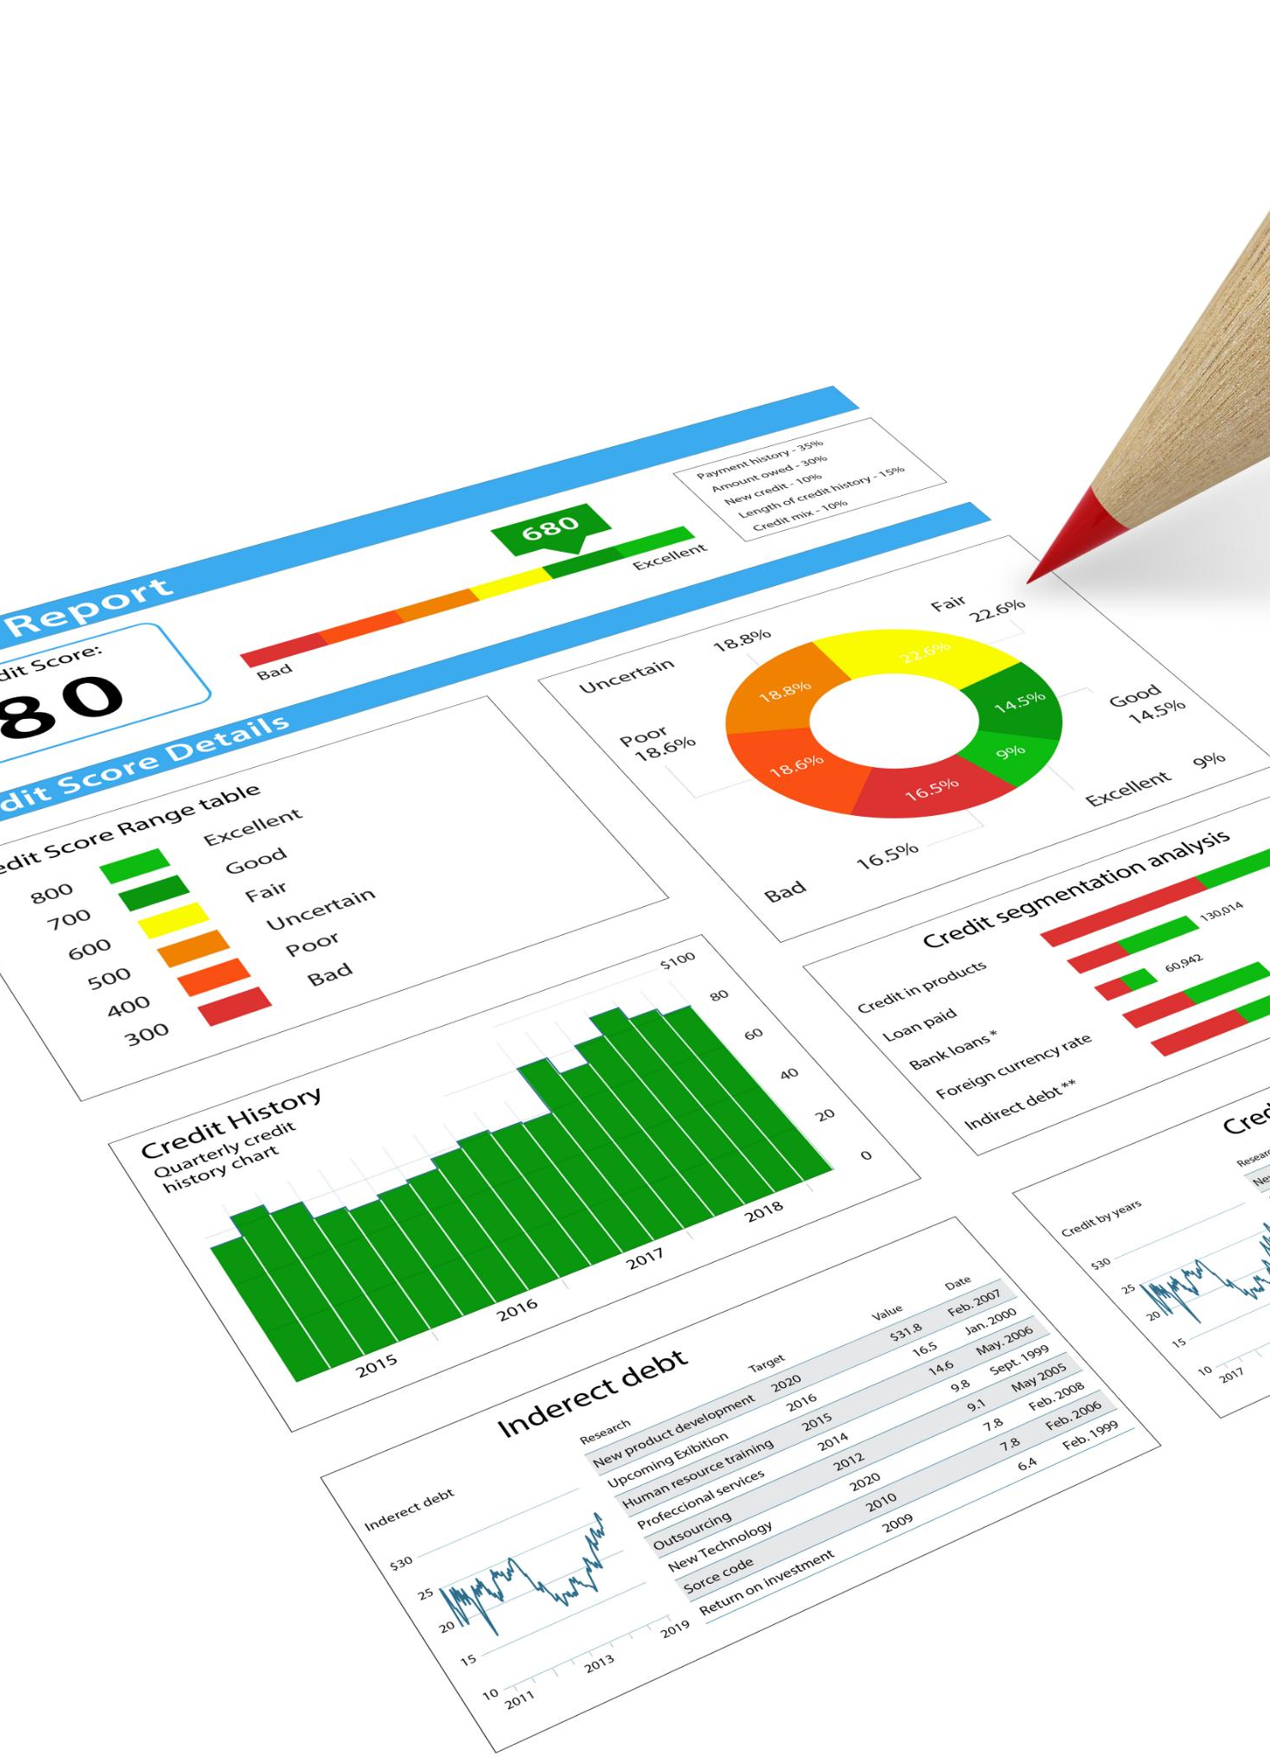
Identifying and Resolving Performance Bottlenecks
Analyzing Slow Queries
Examining slow-running queries reveals inefficient operations causing system delays and poor performance.
Detecting Deadlocks
Identifying deadlocks helps prevent transaction conflicts and system freezes, improving stability.
Monitoring Resource Waits
Tracking resource waits uncovers bottlenecks related to CPU, memory or I/O contention for better tuning.
Notes:
--- Analyzing slow-running queries, deadlocks, and resource waits helps pinpoint bottlenecks, allowing for targeted optimizations. Image source: Microsoft 365 content library

Slide 31
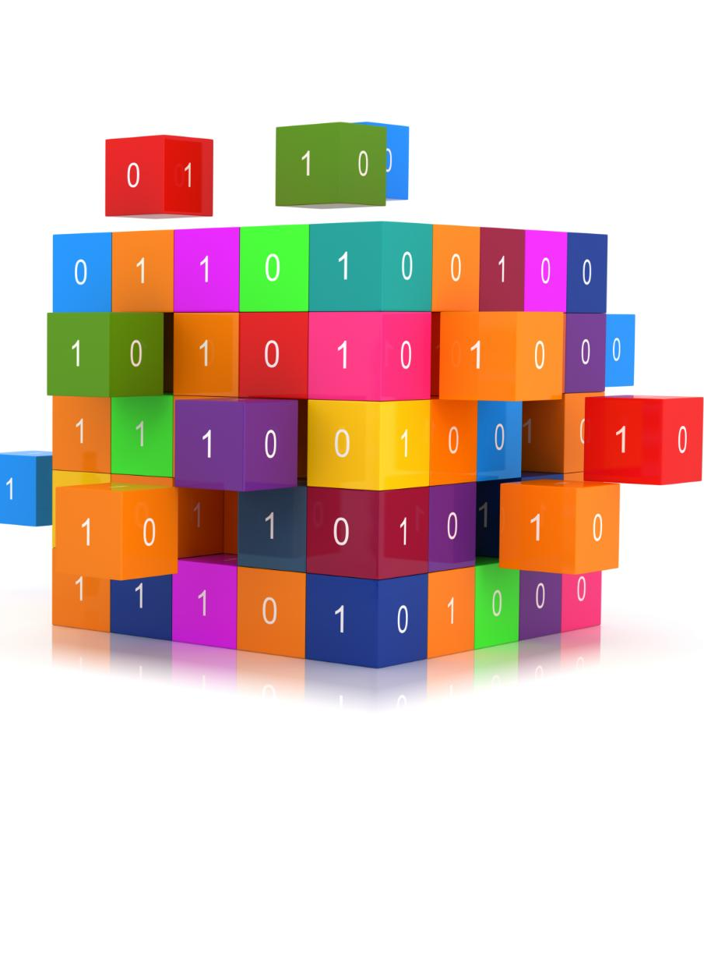
Optimizing Queries and Database Configurations
Query Rewriting
Rewriting queries improves execution efficiency by simplifying or restructuring them for faster results.
Appropriate Indexing
Implementing proper indexes accelerates data retrieval and reduces query processing time.
Scaling Compute Resources
Scaling compute resources ensures the database handles workloads efficiently while controlling costs.
Notes:
--- Techniques such as query rewriting, appropriate indexing, and scaling compute resources optimize database performance and cost efficiency. Image source: Microsoft 365 content library

Slide 32
Conclusion
Understanding Architecture
Comprehending Azure SQL's architecture is crucial for leveraging its capabilities and scalability.
Best Practices in Development
Applying design and development best practices enhances Azure SQL efficiency and reliability.
Data Security and Migration
Securing data and effective migration ensure integrity and continuity in Azure SQL environments.
Performance Monitoring
Continuous monitoring optimizes Azure SQL performance and availability for better results.
Notes:
Mastering Azure SQL involves understanding its architecture, applying best practices in design and development, securing and migrating data effectively, ensuring availability, integrating with Azure services, and continuously monitoring performance for optimal results.

Slide 33

Thank You!!
www.vinsys.com
trainer@vinsys.com

